Slide 1

Styling Websites
Code Club - 9/17/23

Slide 2


Weekly Showcase

Slide 3


Slide 4
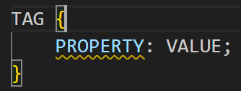
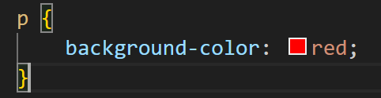
Cascading Style Sheets (CSS)
CSS is a language for defining the styles (appearance) of HTML content
All CSS code targets an element on the page

Slide 5
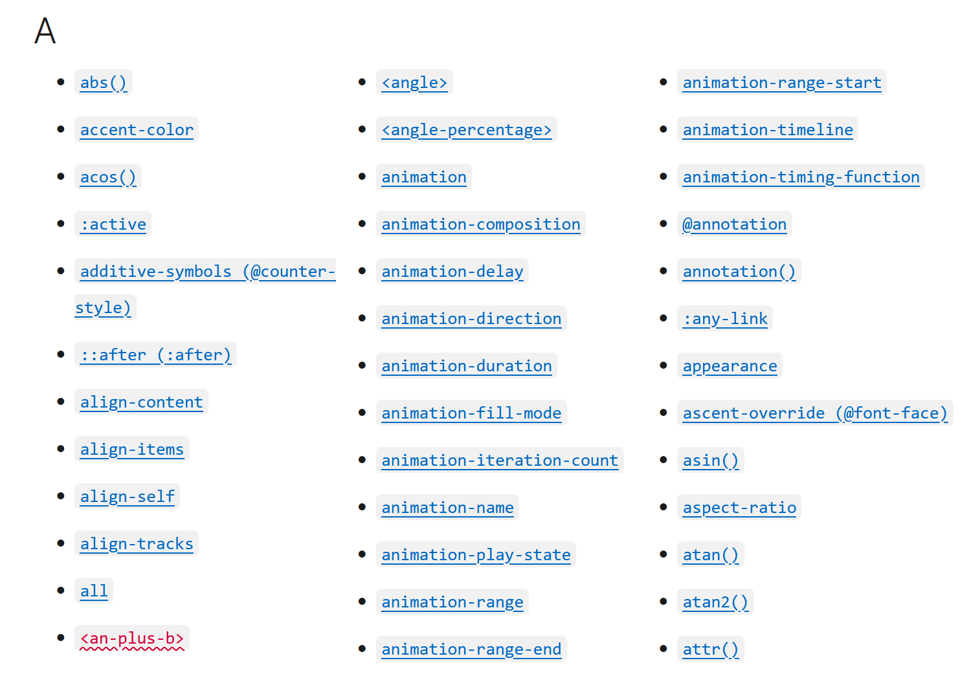
CSS Properties List
Property Categories:
Page Layouts
Colors
Animations
Alignment
Borders
Whitespace
Orientations
Layering
https://developer.mozilla.org/en-US/docs/Web/CSS/frequency#hz

Slide 6
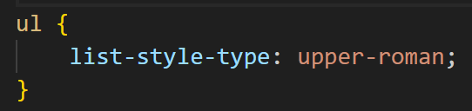
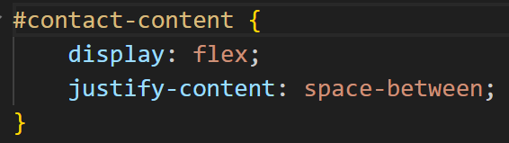
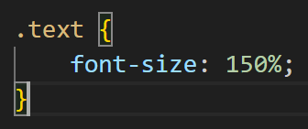
CSS Selectors: Tagnames, IDs, and Classes
CSS code can target tags by name (e.g. ul), ID, or class
IDs are unique names
Classes are non-unique names

Slide 7
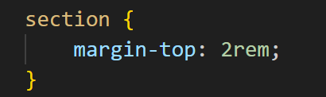
Styling Sections: Creating Whitespace
Create a new file called section.css
Copy the code below into the new file
Add the code below in the <head> of your index.html

Slide 8
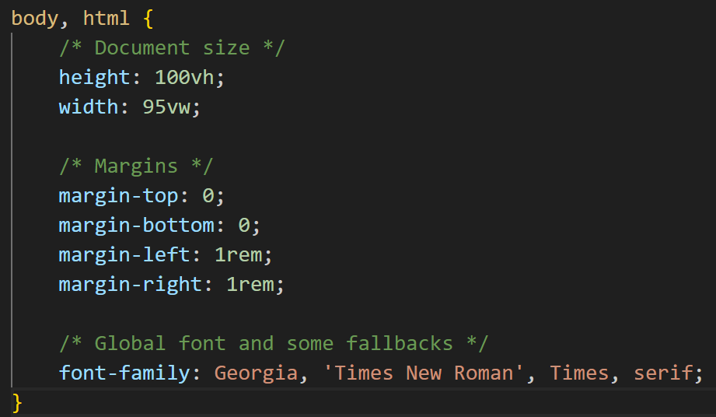
Styling the Body
The <body> and <html> tags should be made fullscreen
Most documents have at least 1-character horizontal margins
Set the font with the font-family property

Slide 9
Start Learning!
https://www.w3schools.com/Css/

